Slide 1

HandInHand

Slide 2
Campus
Question-and-Answer

Slide 3
Campus Websites
Zhihu
Baidu Knows
RenRen
BBS
Quora
Campus Commander
Baidu
Google
Campus Post Bar
segmentfault
Notes:
调的好看一些。。。

Slide 4
Which professor teaches Mathematical Analysis the best？

Slide 5
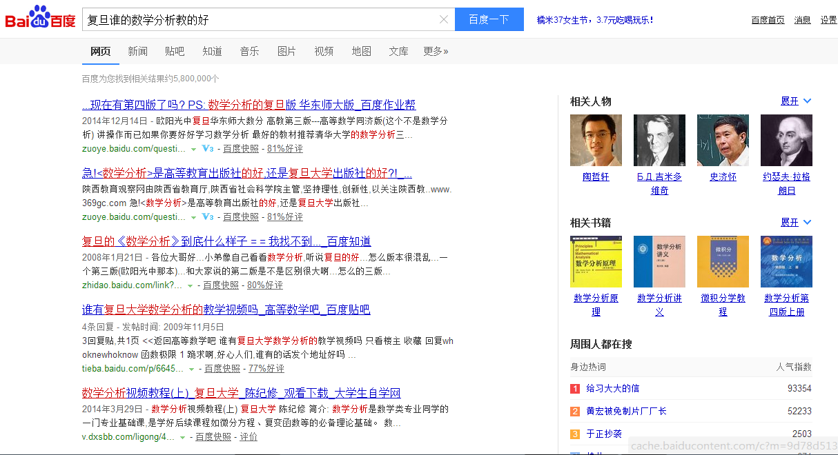

Slide 6
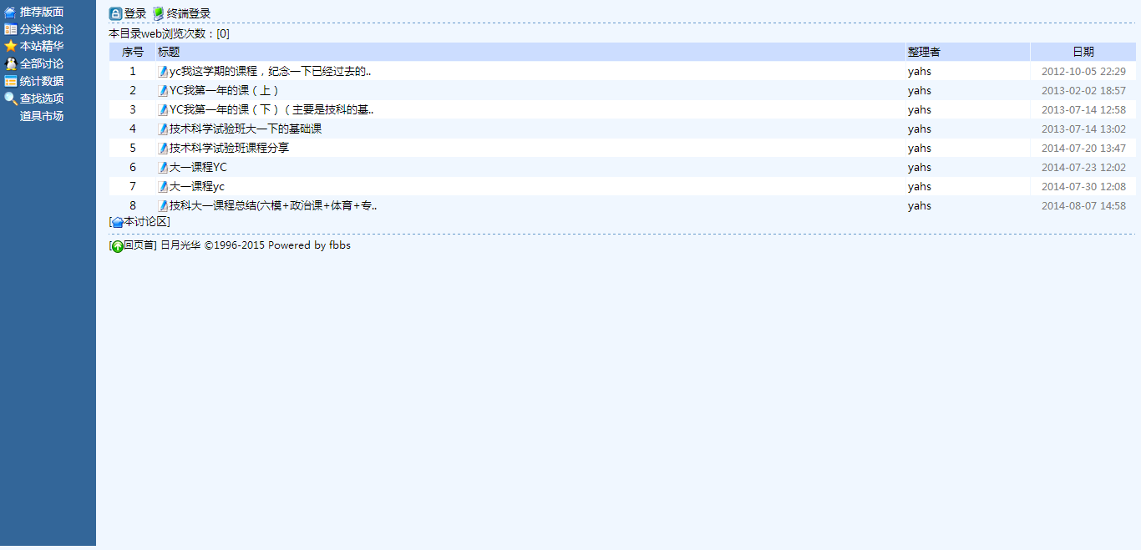

Slide 7
Are there many people waiting for the campus bus now？

Slide 8
Which laboratory should I join？Could you please give me some recommendations?

Slide 9
Pertinent
Time- Sensitive
Campus- Social

Slide 10
Pertinent
Time- Sensitive
Campus- Social

Slide 11




Pertinent

Slide 12

Campus-Oriented
Time-Sensetive
Well-designed classification

Slide 13
Pertinent
Time- Sensitive
Campus- Social

Slide 14
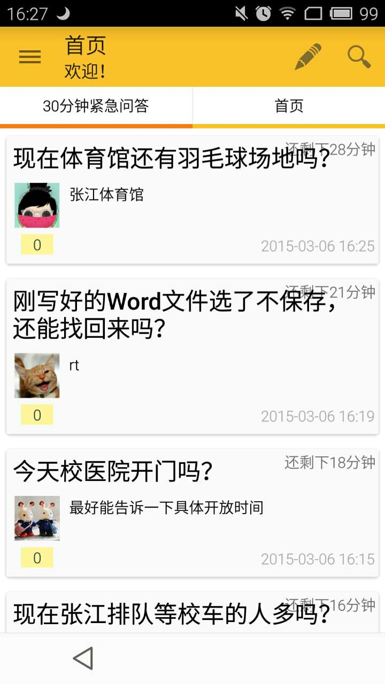
Content
Time-Sensitive
Time-Sensitive

Slide 15
Pertinent
Time- Sensitive
Campus- Social

Slide 16
Questions
Campus-social
Focus

Slide 17
Thanks
Q&A

